Slide 1
What’s new in PowerShell 7

Slide 2

@TylerLeonhardt – Software Engineer - Microsoft

Slide 4


Slide 5
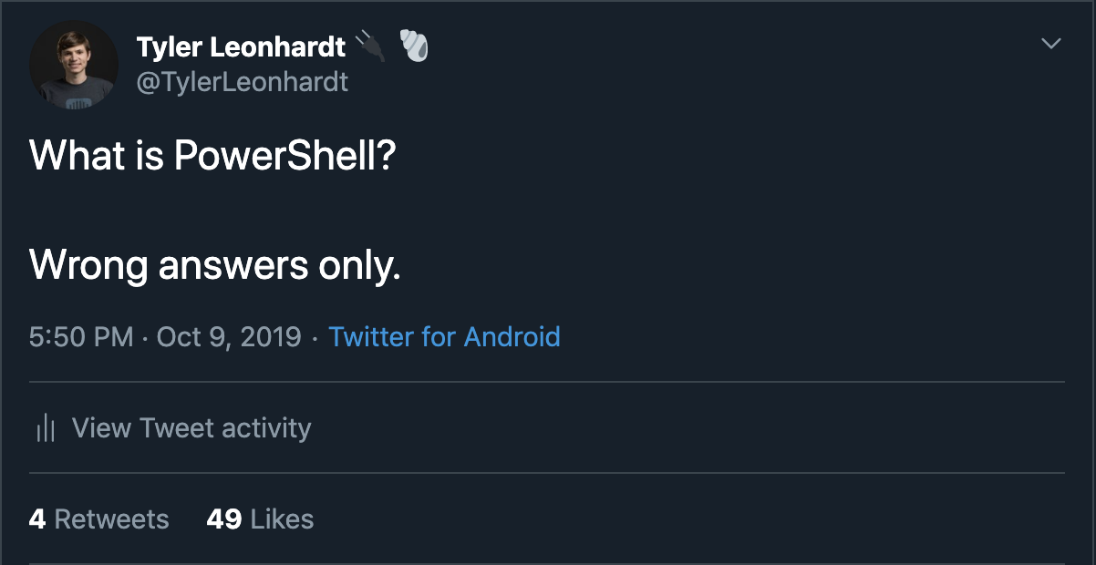

Slide 6


Slide 7


Slide 8



Slide 9



Slide 10
This is not a very surprising talk…
… Because all this information is out in the open!

Slide 11
What is exciting is that you can directly impact PowerShell’s future…

Slide 12
Here’s how we’ll do this…
# NOTE: This is not a real cmdlet :P
Get-PS7Feature | ForEach-Object {
}
Write-Host $_.Description
if ($_.IsInRelease -or $_.IsInMaster) {
$_.Demo()
}
else {
Write-Host $_.Timeline
}

Slide 13
The big one… .NET Core 3.0
Massively improved built-in Windows module compatibility (seriously… go and try it!)
AppBackgroundTask
BitsTransfer
DeliveryOptimization
Dism
HgsClient
International
Kds
PKI
Provisioning
PrintManagement
ProcessMitigations
ShieldedVMDataFile
TroubleshootingPack
UEV
… and maybe more!
Many many more types are back

Slide 14
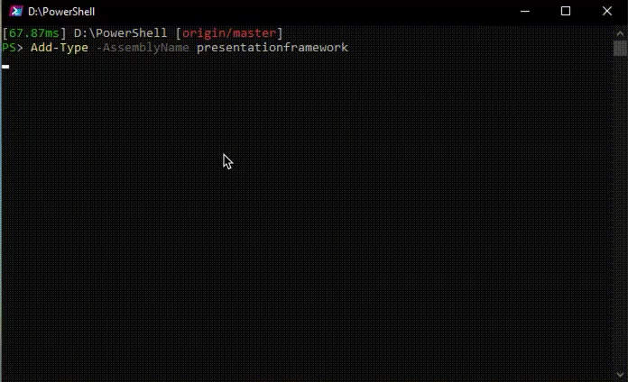
The big one… .NET Core 3.0
WPF & WinForms - Windows GUI’s work again!

Slide 15
Out-GridView?
We’re working on it. We don’t think it’ll make it for 7. However, try out the new cross-platform Out-GridView:
Install-Module GraphicalTools
Get-Process | Out-GridView

Slide 16
“PowerShell 7 is a viable replacement for Windows PowerShell”
- PowerShell Team 2019

Slide 17
Now let’s talk about new features

Slide 18
Secrets Management
A new independent module called Microsoft.PowerShell.SecretsManagement to allow for simple and secure management of secrets on a local machine
Secrets are stored securely in a local vault but this could be generic that services like Azure Key Vault or Hashicorp Vault could leverage
Still in the works – Comment on the RFC:
https://github.com/PowerShell/PowerShell-RFC/pull/208

Slide 19
New Version Notification
Notification inside of PowerShell for when a new version of PowerShell is available
Related: The latest version of the PowerShell extension for VS Code can notify and even allow you to update PowerShell with a click of the button
Still in the works – Comment on the RFC:
https://github.com/PowerShell/PowerShell-RFC/pull/162

Slide 20
Ternary Operator
Quick conditional syntax famous in other languages (C, C#, JavaScript, etc)
Shipped!
$true ? "This gets returned!" : "This does not."

Slide 21
Pipeline Chain Operators
Famous syntax in bash and cmd for handling control flow
Pull request out! Comment on the RFC:
https://github.com/PowerShell/PowerShell-RFC/pull/192
throw "bad" && "This will never run :(”
throw "bad" || "This will run! :)"
apt update && apt install cowsay

Slide 22
Null Coalescing and Null Coalescing assignment
A C# syntax brought over to PowerShell
Pull request out! Comment on the RFC:
https://github.com/PowerShell/PowerShell-RFC/pull/223
$x = $null
$x ?? 100
100
$x ??= 'new value'
$todaysDate ??= (Get-Date)
(Get-Module Pester -ListAvailable) ?? (Install-Module Pester)

Slide 23
Parallel Foreach
The name says it all… Foreach-Object now has a -Parallel switch to run iterations in parallel
Shipped!
1..50 | ForEach-Object -Parallel { Start-Sleep -Milliseconds 100 }
Notes:
(Measure-Command { 1..50 | ForEach-Object { Start-Sleep -Milliseconds 100 } }).TotalMilliseconds
(Measure-Command { 1..50 | ForEach-Object -Parallel { Start-Sleep -Milliseconds 100 } }).TotalMilliseconds
(Measure-Command { 1..50 | ForEach-Object -ThrottleLimit 20 -Parallel { Start-Sleep -Milliseconds 100 } }).TotalMilliseconds
Diminishing returns
(Measure-Command { 1..50 | ForEach-Object -ThrottleLimit 50 -Parallel { Start-Sleep -Milliseconds 100 } }).TotalMilliseconds

Slide 24
$ErrorActionPreference = “break”
Enable this to break into the debugger as soon as there’s an Error
Shipped!
Community contributed by Kirk Munro!
$ErrorActionPreference = "break"
1/0
Entering debug mode. Use h or ? for help.
At line:1 char:1
+ 1/0
+ ~~~
PS >
Notes:
Function foo {
Get-ChildItem “Something” -EA Stop
}

Slide 25
Easier to read Error View
New ”concise” error view so that errors aren’t as jarring
In master! Will be in PowerShell 7 Preview 5!
$ErrorView = "concise”
Get-ChildItem dne
"Get-ChildItem: Cannot find path '/Users/tyleonha/dne' because it does not exist."

Slide 26
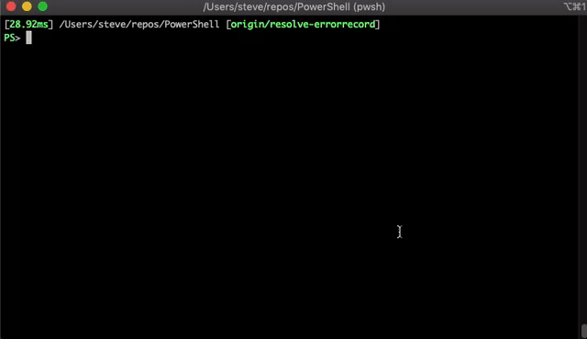
Resolve-ErrorRecord
”concise” view was all about reducing error noise, this cmdlet provides a ton of extra details about an ErrorRecord

Slide 27
PowerShell as a Login Shell on Linux and macOS
Login shells in UNIX-like OS’s are shells that are provided environmental state upfront. For a while PowerShell didn’t support that… but now it does!
chsh -s /usr/local/bin/pwsh-preview
$env:PATH
/Users/tyleonha/.powershell-daily:/usr/local/bin:/usr/bin:/bin:/usr/sbin:/sbin:/usr/local/share/dotnet:~/.dotnet/tools:/Library/Frameworks/Mono.framework/Versions/Current/Commands:/Applications/Xamarin Workbooks.app/Contents/SharedSupport/path-bin

Slide 28
Invoke-DscResource without LCM
Directly run a DscResource
Invoke-DscResource -Name psmodule -Method Test -Property @{ Name = "Pester" }

Slide 29
Those are just some…
This list is not exhaustive. There are more features in PowerShell 7 that I didn’t cover.
Performance has increased across the board thanks to .NET Core, and optimizations from the team AND community

Slide 30
Get involved!
Comment on RFCs or issues
Contribute to docs or code

